Slide 1
Vehicle Rental Statewide Contracts
Statewide Contract Webinar – October 3, 2013
SPD-CP031
Revised 02/10/11
Georgia State Purchasing Division
http://statepurchasing.doas.georgia.gov

Slide 2
Your Presenter State Purchasing Division – Statewide Contracts
Debra White
Title: Category Manager, DOAS State Purchasing
Certifications: MA Bus, CPM, CPPO, GCPA
Contact Information
Debra.white@doas.ga.gov
404-463-0232e@doas.ga.gov
404-XXX-XXXX

Slide 3
Supplier Partner Representatives
George Hill
Title: The Hertz Corporation
Account Manager
Contact Information
ghill@hertz.com
404-403-3474
Heather Pastrick
Title: Director of Business Sales
Contact Information
heather.s.pastrick@ehi.com
404-886-8668
Corey Rhodes
Title: Regional Vice President
Contact Information
corey@busmaxrental.com
706-291-0600

Slide 4
Purpose of this Webinar State Purchasing Division – Statewide Contracts
1.EXPLAIN
the purpose
2. SOURCING process overview
3. PROVIDE
specific details
4. IDENTIFY
the benefits
5. FIND the contract
on the website
6. REVIEW
FAQs
7.DESCRIBE
how to use the contract

Slide 5
Purpose of this Webinar State Purchasing Division – Statewide Contracts
Purpose:
The purpose is to provide an overview of the Vehicle Rental Program effective October 7, 2013.

Slide 6
Sourcing Process Overview
Solicitation Development
Market Research
Spend Analysis
Customer/Stakeholder Survey
Vendor Survey
Sourcing Team
Requirement Development
Requirement Validation
Solicitation Details
Segment Award
Multiple Award
Technical & Cost
Solicitation Results
Capitol Hill
On-Airport (Inter-State)
In-State
15 Passenger Bus and Other Bus Types
Vehicle Leasing

Slide 7
Statewide Contract Details State Purchasing Division – Statewide Contracts
What are the Contract Numbers?
Contract # 99999-SPD-40199376(CR-01), (IS-01,02), (BS-01)
Is it a Renewal?
No
Does it Replace an Existing Contract?
Yes
What is the Contract Term?
5 Years
What are the Expiration Dates?
2015
Does it Allow the Use of the P-Card?
Yes
Who is the Person to Contact with Questions:
Debra White
Debra.White@doas.ga.gov
404-463-0232

Slide 8
Vehicle Rental Services Providers
Capitol Hill – The Hertz Corporation
Inter-State (Airport) – The Hertz Corporation
In – State (Georgia locations other than Airport) The Hertz Corporation and Enterprise Car Rental
15 Passenger Bus and Other Bus Types – AutoMax Rent-a-Car dba BusMax

Slide 9
Hertz/State of GA Rental Program
Hertz is proud to be your low cost provider on Airport, Capitol Hill, and throughout Georgia!!
Free Pick-up and Delivery/Staging available!
All state renters greater than 15 miles from nearest Hertz can be delivered or staged at facility for free.
LDW/Liability/Mileage included in rates.
Direct billing available in-state and out of state.
Personal Travel Program
Hertz Gold Rewards

Slide 10
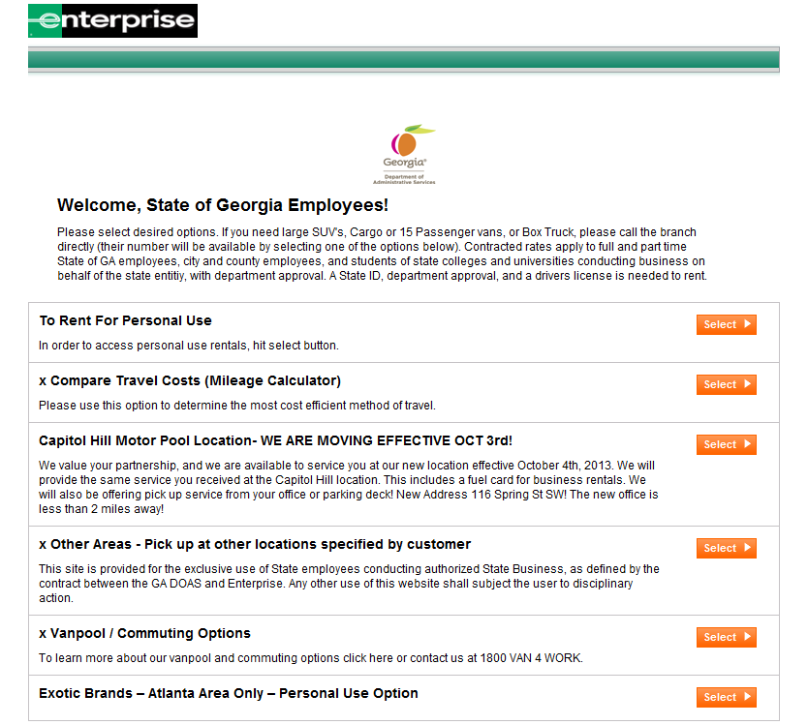
Enterprise & State of Georgia
Over 200+ Georgia Locations to service you
New Loyalty program for travelers to earn points that they can redeem for free rental days!
https://www.enterprise.com/car_rental/deeplinkmap.do?bid=044&cust=03a1534
Book your reservations thru www.enterprise.com/stateofgeorgia
Or your agencies dedicated link
New State of Georgia downtown office off Spring Street that will still be offering fuel cards and shuttle/pick up service

Slide 12
Capitol Hill and Inter-State (Airport) Rental Rates
Hertz Capitol Hill Standard Rate
Vehicle Class | 1/2 Day (hourly) | Daily | Weekly | Monthly
Compact | $12.50 | $25.00 | $150.00 | $600.00
Intermediate | $13.00 | $26.00 | $156.00 | $624.00
Full Size | $14.00 | $28.00 | $168.00 | $672.00
12 Passenger Van | $29.50 | $59.00 | $354.00 | $1,416.00
Mini Vans | $24.50 | $49.00 | $294.00 | $1,176.00
Mid-Size SUV | $24.50 | $49.00 | $294.00 | $1,176.00
24% Avg Savings
37% Calculated Benefit
*Hertz Inter-State (Airport) Standard Rate
Vehicle Class | Daily | Weekly | Monthly
Compact | $32.00 | $192.00 | $768.00
Intermediate | $34.00 | $204.00 | $816.00
Full Size | $37.00 | $222.00 | $888.00
12 Passenger Van | $88.55 | $531.30 | $2,125.20
Mini Vans | $63.25 | $379.50 | $1,518.00
Mid-Size SUV | $59.80 | $358.80 | $1,435.20
12% Calculated Benefit
*.025 per mile one way rental

Slide 13
In-State Rental Rates
Hertz In-State Standard Rate
Vehicle Class | Daily | Weekly | Monthly
Compact | $28.00 | $168.00 | $672.00
Intermediate | $29.00 | $174.00 | $696.00
Full Size | $32.00 | $192.00 | $768.00
12 Pass Van | $77.00 | $462.00 | $1,848.00
Mini Vans | $55.00 | $330.00 | $1,320.00
Mid-Size SUV | $52.00 | $312.00 | $1,248.00
Enterprise In-State Standard Rate
Vehicle Class | Daily | Weekly | Monthly
Compact | $30.15 | $165.83 | $663.30
Intermediate | $35.25 | $193.88 | $775.50
Full Size | $38.00 | $209.00 | $836.00
12 Pass Van | $82.77 | $455.24 | $1,820.94
Mini Vans | $49.68 | $273.24 | $1,092.96
Mid-Size SUV | $50.60 | $278.30 | $1,113.20
Enterprise Box Truck Rental Rates
Cargo Van | $82.99
15 ft. Box Truck | $91.99
16 ft. Box Truck | $95.00
24 ft. Box Truck | $97.99
11% Avg Savings
5% Avg Savings
for
Car Rental

Slide 14
15 Passenger Bus and Other Bus Types
Bus Type/Capacity |  | Daily Rate
*Multi Functional School Activity Bus |  | $ 159.00
15 Passenger Comfort |  | $ 299.99
25 Passenger |  | $ 303.88
33 Passenger |  | $ 425.08
44 Passenger |  | $ 526.08
Vehicle Pick Up and Drop Off Fee
$50.00 Plus Mileage
Special Notes
A CDL is not required to drive a 15 +1 MFSAB, unless transporting school children.
Drivers transporting Georgia public school students must meet all training and other Georgia school bus driver requirements.
* Only bus certified to transport school children

Slide 15
Key Benefits State Purchasing Division – Statewide Contracts
Key Benefits:
Capitol Hill savings of 37.1% calculated savings
Inter-State (Airport) calculated savings of 11.8 %
Up to 19% calculated savings for In-State Car Rental
Expanded box truck options
Fuel cards available at the Capitol Hill location
Convenient airport locations
50% increase of rental locations as the result of the multiple supplier award
Updated Vehicle Cost Comparison
Agency billing
Compatible with the TeamWorks Travel & Expense system

Slide 16
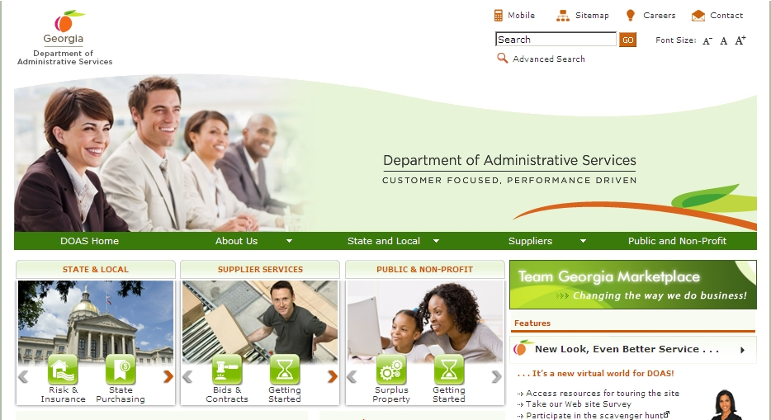
Where to Find this Statewide Contract State Purchasing Division – Statewide Contracts
1. Visit the DOAS website at www.doas.ga.gov.

Slide 17
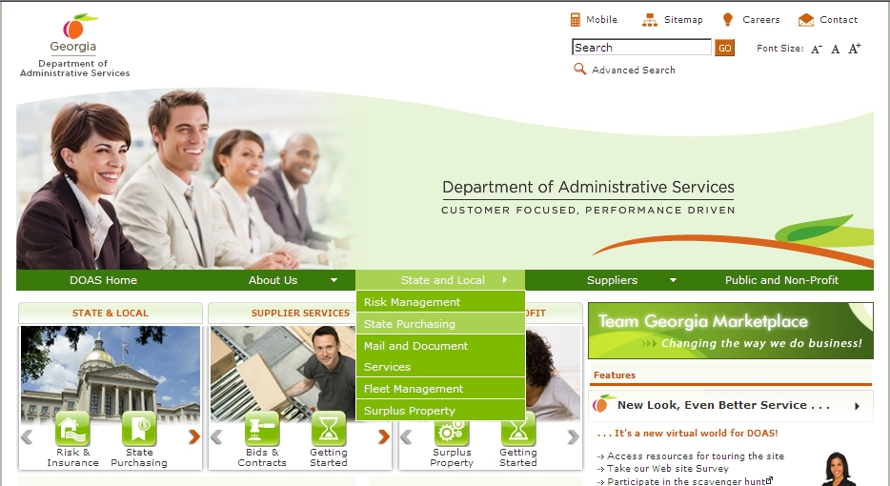
Where to Find this Statewide Contract State Purchasing Division – Statewide Contracts
Hover over the State and Local section of the screen
2. Hover over the State and Local section of the screen.
3. Click on State Purchasing.

Slide 18
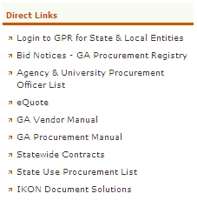
Where to Find this Statewide Contract State Purchasing Division – Statewide Contracts
Click on Statewide Contracts
4. In the Direct Links section, click on Statewide Contracts.

Slide 19
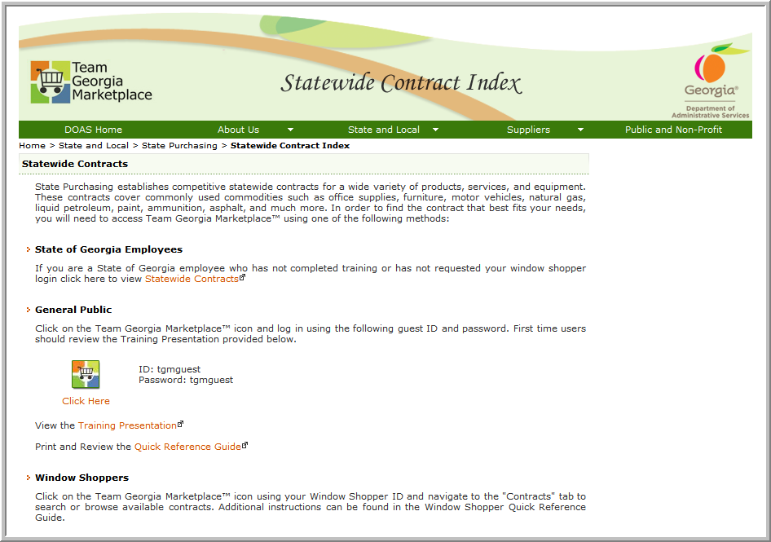
SWC Index for Public
5. To access contract information, click on the Team Georgia Marketplace™ icon to access the Login screen. This User Name and Password is generic and only provides access to contract information.
Use tgmguest
as the User Name and the Password

Slide 20
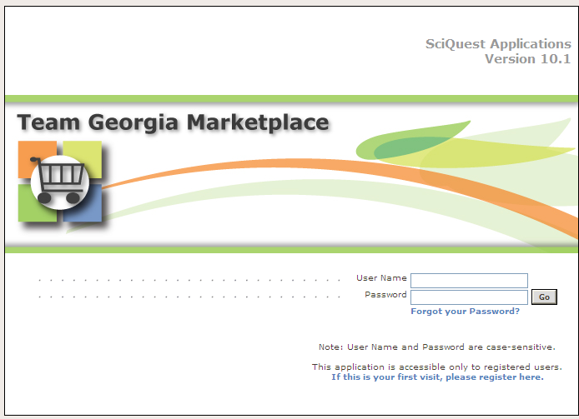
Statewide Contracts Index
6. When the Login screen displays, use tgmguest as the User Name and the Password. This generic ID and Password allows access to contract information only.
Use tgmguest
as the User Name and the Password

Slide 21
SWC Index for Window Shoppers
You can also click on the Team Georgia Marketplace™ icon to access the same Login screen, but enter your personal Window Shopper User Name and Password. This allows you to access the Statewide Contract Index as well as to shop for items available from the Statewide Contracts.

Slide 22
SWC for Window Shoppers
If you are a Window Shopper user, you can access the Statewide Contract Index by entering your personal User Name and the Password once the Login screen displays. Then, click on the Contracts tab.
Use your Window Shopper User Name and Password

Slide 23
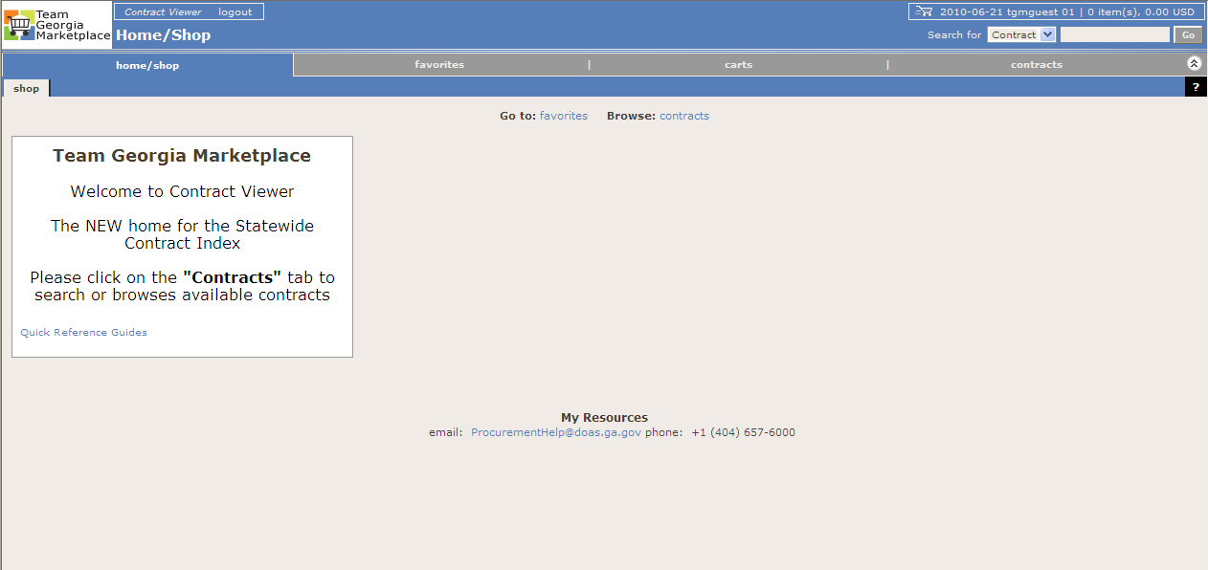
Team Georgia Marketplace Contracts
Once you access the system using the generic or your personal User Name and Password, click on the Contracts tab to access the Statewide Contracts.
Click on the Contracts tab

Slide 24
How to use this contract State Purchasing Division – Statewide Contracts
Car Rental
Fiscal officers must ensure your agency has filled out the electronic Agency Bill Form for Hertz rentals. Enterprise agency bill information will remain the same.
Enterprise: Use portal for In-State rentals, call rental location, 1-800-Rent-a-Car or walk-in
Hertz: Use portal for In-State, Capitol Hill and Inter-State (Airport) rentals; call rental location or 1-888-444-8500 or walk-in
Auto Max dba BusMax: www.busmaxrental.com Call closest rental facility: Cartersville – 770-607-7000, Norcross – 770-Bus-Rent, Rome 706-291-0600

Slide 25
Frequently Asked Questions State Purchasing Division – Statewide Contracts
Question | Answer
When will the vehicle rental contracts expire? | The vehicle rental contracts expired September 30, 2013.
When will the new contracts take effect? | October 7, 2013 for all vehicle rental segments.
Is there a contract in effect from October 1 – October 6, 2013? | No.
When can I begin making reservations under the new contracts? | You can begin making reservations with Hertz – Oct 3, Enterprise - Oct. 4, BusMax - Oct. 3.
Will the Vehicle Cost Calculator be updated? | Yes. Updates will begin to appear Oct. 7 – 15.

Slide 26
For more information State Purchasing Division – Statewide Contracts
Submit Questions To:
Email Address:
Debra.white@doas.ga.gov
Person to Contact:
Debra White
Phone Number:
404-463-0232
This Webinar
A copy of this webinar will be posted on the State Purchasing Division website.

Slide 27
Supplier Contact Information
The Hertz Corporation
George Hill
Account Manager
ghill@hertz.com
404-403-3474
Enterprise Car Rental
Heather Pastrick
Director of Business Sales
heather.s.pastrick@ehi.com
404-886-8668
BUSMAX
Corey Rhodes
Regional Vice President
corey@busmaxrental.com
706-291-0600

Slide 28
Questions…
?

